Slide 1

Moving to Las Vegas
Coursera IBM Data Science Capstone
Aug 1st, 2019
Stefano Magarotto

Slide 2
Table of Contents
1. Introduction / Business problem
2. Data Section

Slide 3
1. Introduction / Business problem
1.1 Scenario
I am currently living in Italy in a sparkling university town called Padova/Padua. I have plenty of venues and attractions especially parks for children, shopping venues for my wife and theatres for me. I got a job in Las Vegas and I am planning to relocate if I can find a place to live with similar venues.
1.2 Problem to be solved
I need to find a Las Vegas area with:
similar venues
availability of a single house with min 2 bedrooms, 2 bathrooms, a garage and a garden with swimming pool, no HOA fees, build after 2009 and a budget of $500k
nearby primary, middle and high schools
maximum distance from Caesars Palace Casino (job location): 10 miles

Slide 4
1. Introduction / Business problem
1.3 Potential audience
This project can be useful for all those people that need to relocate with their families in the same country or in different countries or even continents.
It can be useful for businesses that are planning to relocate and are considering their employees needs in the global balance of pros and cons.
It can be adapted to the case of evaluating a new business opportunity in a certain area.
Last, but not least, it can be useful for everyone interested in Data Science as a possible solution for a practical case.

Slide 5
2. Data
2.1 Data sources
Geodata for Padova/Padua with venues (Nominatim or geocode, Foursquare and Folium)
Geodata for Las Vegas neighborhoods including the surrounding cities of North Las Vegas and Henderson, plus the Census-designated places of Blue Diamond, Enterprise, Paradise, Spring Valley, Summerlin South, Sunrise Manor, Whitney and Winchester with venues (Wikipedia, Nominatim or geocode, Foursquare and Folium)
List of houses to buy (zillow, Nominatim or geocode and Folium)

Slide 6
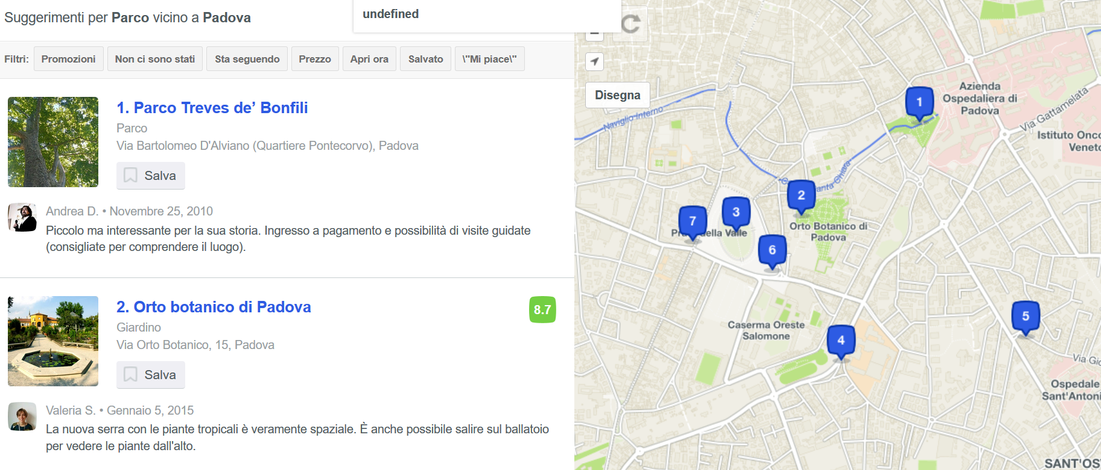
2. Data
2.2 Data features
Padova/Padua
My location: latitudine and longitude (45.3959547,11.8802724)
Parks: from Foursquare with a specific radius of 1km
The same for schools, shopping venues, theatres (from Foursquare) and a specific radius of 1km.
The features we are interested are distance, review score, opening hours and if they are trending.

Slide 7
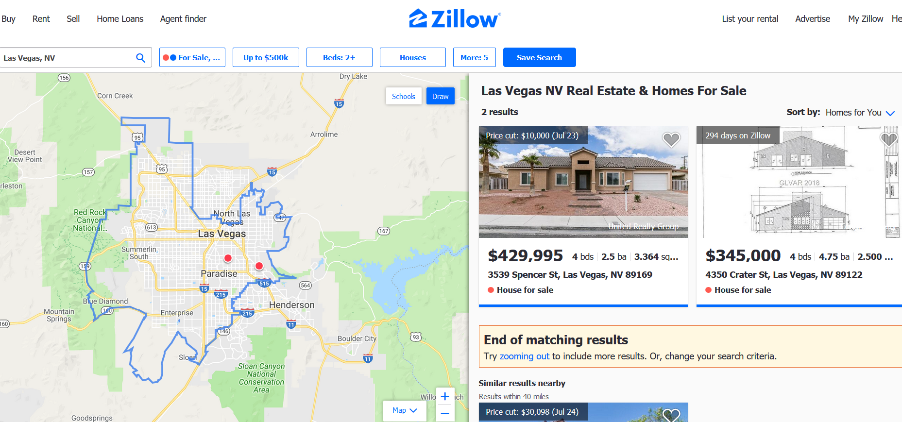
2. Data
Las Vegas
Potential houses to buy (with latitude and longitude)
As for Padova/Padua, in Las Vegas we use foursquare with a radius of 1km.
So parks, schools, shopping venues, theatres (from Foursquare) and a specific radius of 1km.
The features we are interested are distance from house, review score, opening hours and if they are trending.
We consider also the distance of the house from the jobplace (Caesars Palace Casino Las Vegas).

Slide 8
3. Methodology
3.1 Strategy
The strategy is based on mapping the data described in section 2 in order to create a clear view of the options to make easy the choice of the best house in Las Vegas compared to current Padova/Padua home.
First the information will be imported, sorted, trasformed, clustered. Then a single map with all data classified in a clear manner will be created.
Now all the details of the potential houses, clusters of venues in the neighborhoods and job location will be clearly visibile in a single view (the map) with all the details required.
Moreover a measurement tool icon will be provided for user convenience.
The popus of the map items will display all details for every single cluster or house.

Slide 9
3. Methodology
3.2 Tools
First of all I used web-scraping tools to get unstructured data from websites (neighborhoods) and convert it in csv that were imported in dataframes with pandas libraries (read_csv)
After that I used Nominatim and Google APIs to get geodata for all neighborhoods, home, potential houses and job location.
I used Geopy and Nominatim to establish relative distances.
The maps were created with Folium.
The surrounding venues were obtained from Foursquare API using their categoryid to filter only the venues that I was interested in (parks, schools, shopping, arts and entertainment).
I used kmeans from SciKit-learn library to define clusters of the venues in the Las Vegas neighborhoods.

Slide 10
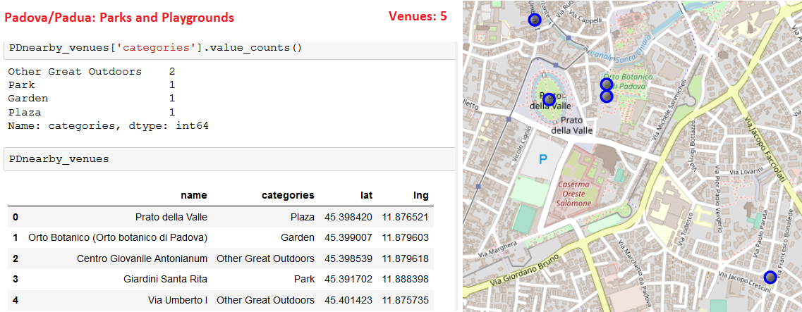
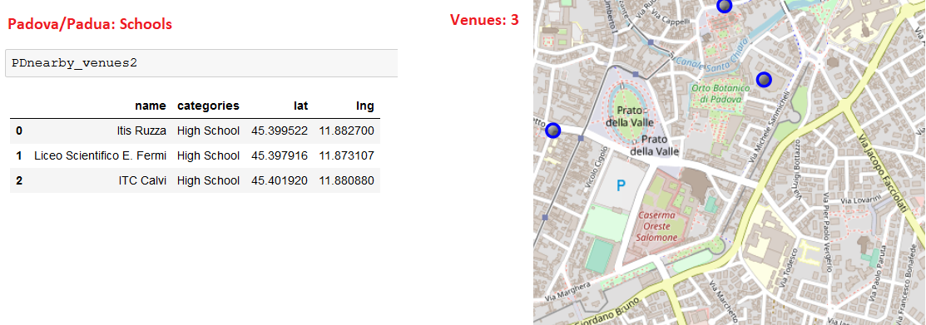
4. Results
4.1 Padova/Padua

Slide 11
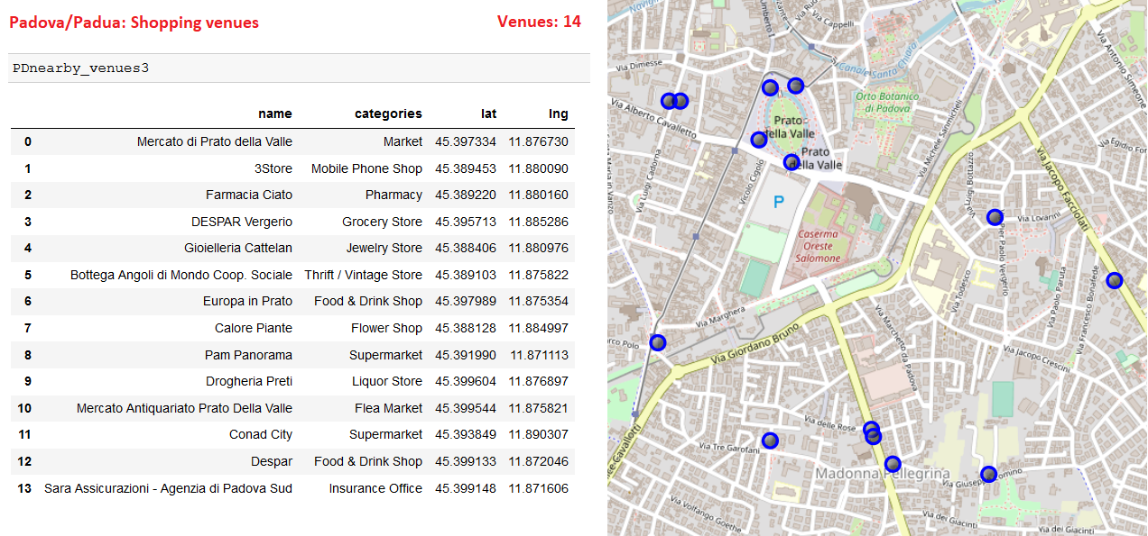
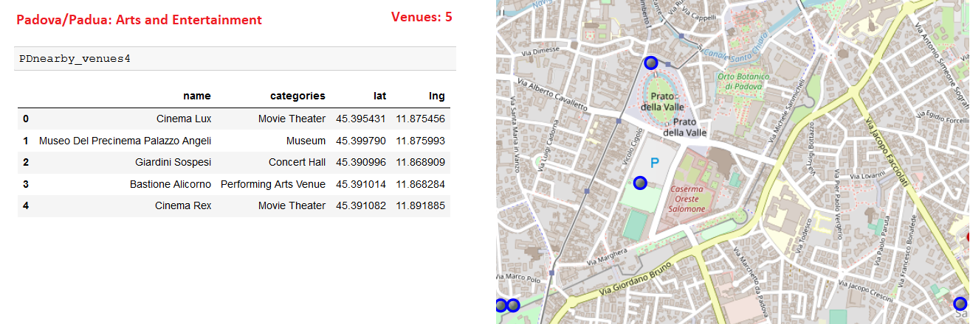
4. Results

Slide 12
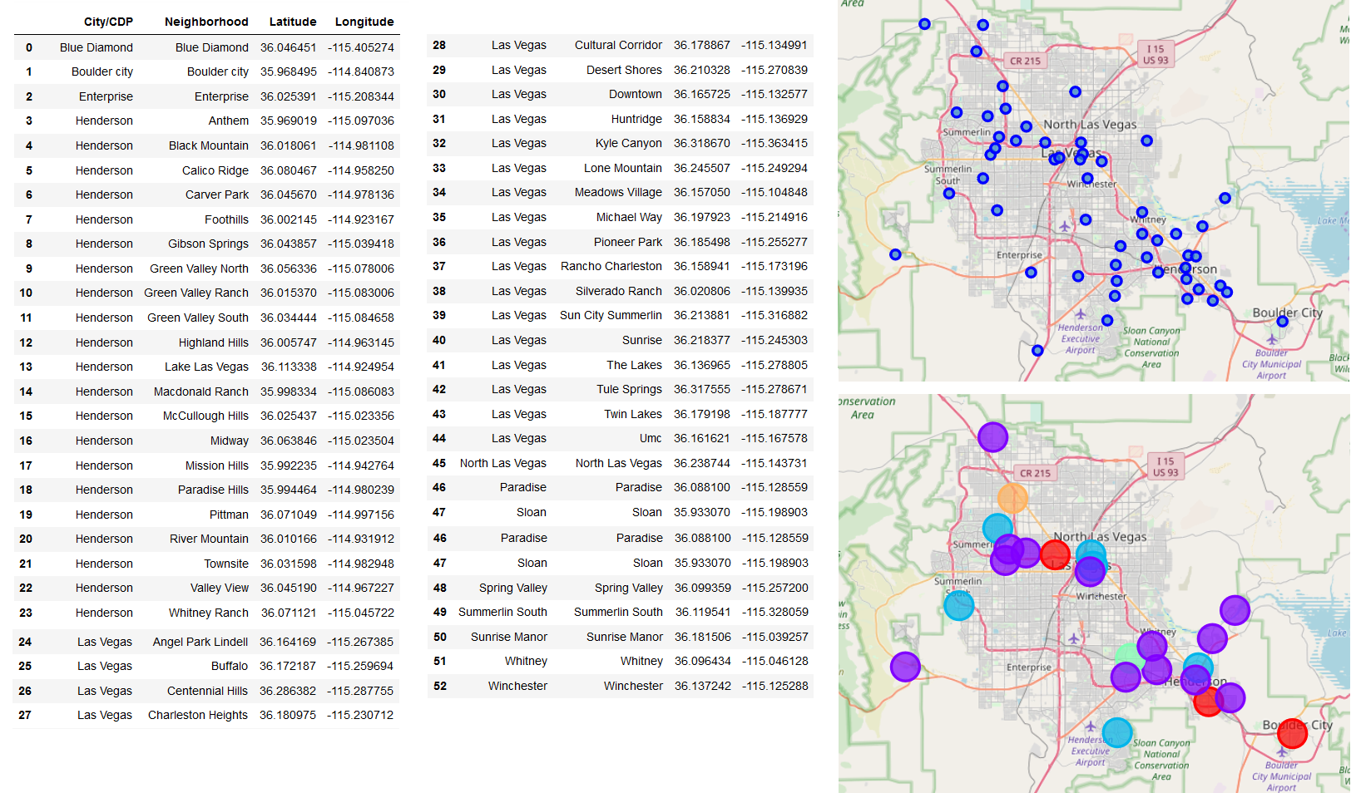
4. Results
4.2 Las Vegas – Neighbordhoods and clusters of venues

Slide 13
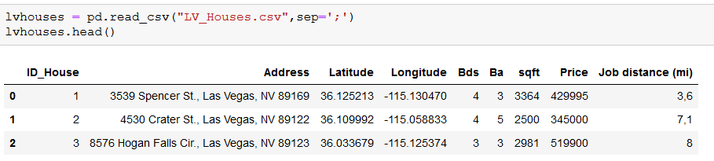
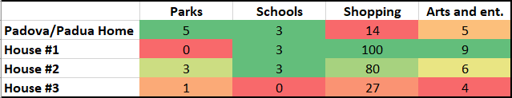
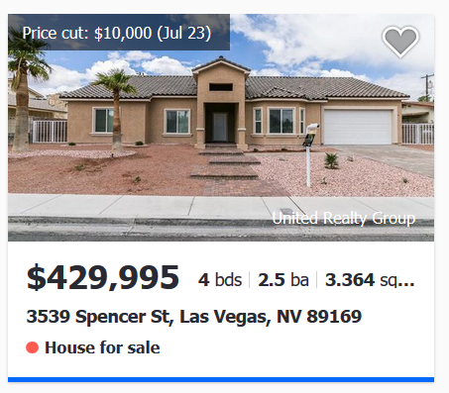
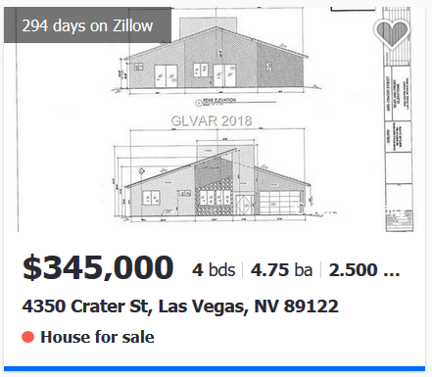
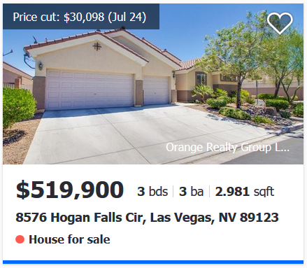
4. Results
4.3 Las Vegas Houses – Geodata and comparison with Padova home

Slide 14
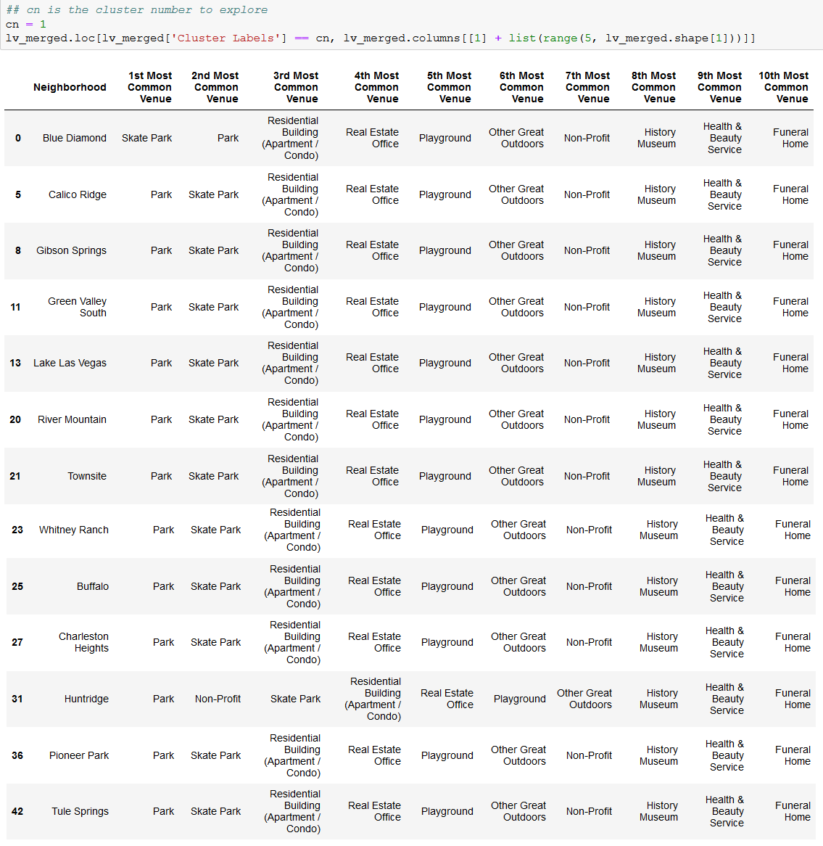
4. Results
4.4 Las Vegas – Cluster 1 (best choice for me from analysis)

Slide 15
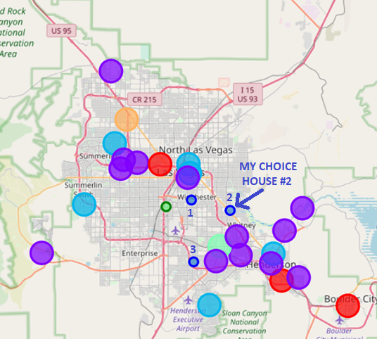
4. Results
4.5 Las Vegas Decision Map – Houses to buy (blue dots), Job location (green dot) and Venue Clusters (bubbles)

Slide 16
5. Discussion
5.1 House Selection
I used the above map to evaluate the different potential houses to buy.
House #1: the price USD429,995 is on the budget and it is only 3.6mi from job location (15 min). There are no parks, but both elementary and middle schools. From parents point of view (pov) there are plenty of shopping and arts and entertainment venues.
House #2: the price USD345,000 is pretty low and much bigger than House #1, it is 7.1mi from job location but around the same time(19 min). There are 3 parks, but only elementary schools. From parents pov there are plenty of shopping venues and average arts and entertainment venues.

Slide 17
5. Discussion
House #3: the price USD519,900 is just a little bit over budget and around the same size like House #1. Distance from job location is 8mi but around the same time (18 min). There is 1 park and no schools nearby. Moreover not so many shopping and arts and entertainment venues.
The venues for all houses are as of Cluster 1 so no real difference.
House #3 is immediately out because an higher price tag gives less comfort and venues. House #2 is comparable to House #1 even somehow better and the price tag is much lower so it is my favourite choice.
Comparing House #2 with Padova/Padua venues, Padova/Padua has more parks and playgrounds, some high schools but no elementary or middle schools around and the same level of arts and entertainment. Shopping venues are less that in House #2 area.

Slide 18
6. Conclusions
I can conclude that venues in House #2 area are pretty much the same like in my Padova/Padua home area even more shopping venues for my wife happiness. It is not far from job location and in a good neighborhood. House #2 is a perfect fit for me and my family.

